Slide 1
AI and ML in Health
Is it A.I., A.I, AI or?
Euan Gardner
SIDM DMSD

Slide 2
All the news
Google Deepmind: Kidney Algorithm
Elon Musk: neural knit works
Search for : ‘Cancer + AI’ returns many results
  Can (not always) out perform humans

Slide 3

Words of caution
AI/ML, traditional statistics and applied statistics all have similar but different language – always clarify

Slide 4
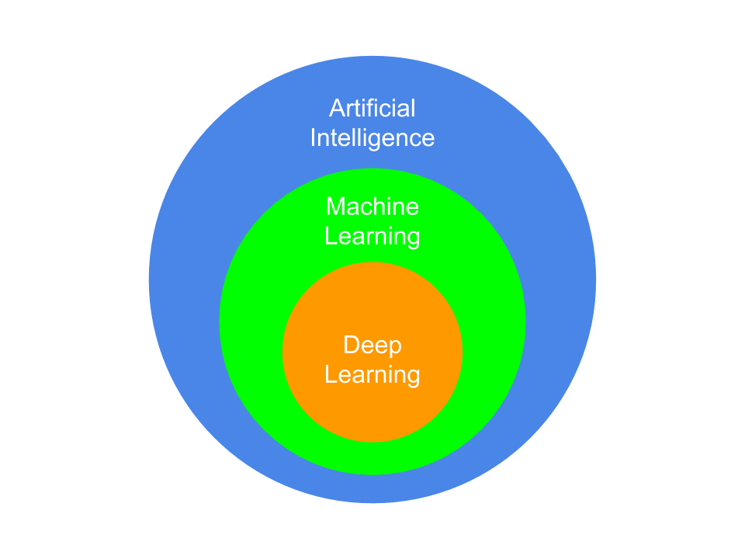
So what is it?

Slide 5
Artifical Intelligence
Focus is on ‘intelligent systems’
Human interaction and human like/superior intelligence part of aim
Most of what is called AI is actually ML...
Sometimes waves to statistics in the street

Slide 6
Machine Learning
Two main flavours of ML
Traditionally focussed on pure algorithm creation
Overall aim: pattern detection
Incresingly becoming best buds with statistics
  ‘statistical learning’

Slide 7
Supervised/Unsupervised ML
Supervised: We know the answers, algorithmn has to find best way to predict through recognising pattern
Unsupervised: Algorithmn has to find best way to describing or grouping data with no labels
Many other subareas exist

Slide 8
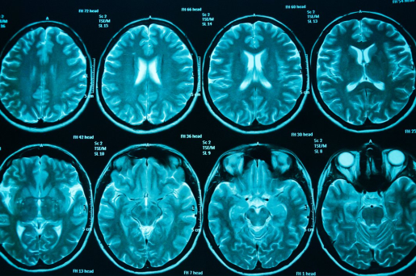
Example
Split: Train
Labelled Data:
Disease Yes/No
Split: Test

Slide 9
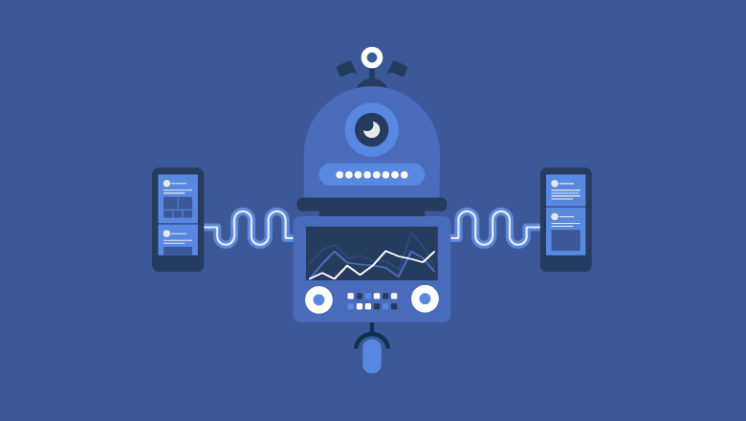


Split: Train
Algorithm
Algorithm updates parameters
based on correct prediction
Did the Algorithm
predict the correct label?

Slide 10
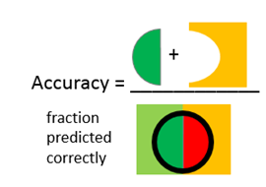
Algorithm
Did the Algorithm
predict the correct label?
Split: Test
Happy with the performance?
Production model
New approach

Slide 11
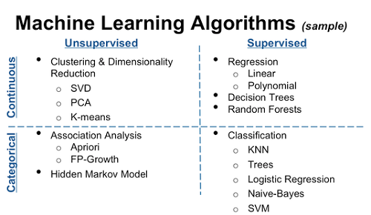
Common Approaches

Slide 12
Where to start?
R has built in datasets: Iris, Titanic etc.
Google open datasets
Really good starter package in R: CARET
Youtube is your friend

